Slide 1



chapter 2
the human

Slide 2
the human
Introduction
Information i/o …
  visual, auditory, haptic, movement
Information stored in memory
  sensory, short-term, long-term
Thinking
  reasoning, problem solving, skill, error
Emotion
Individual differences

Slide 3
Introduction
Cognitive psychology is a study of mental processes such as attention, language use, perception, memory, problem solving, creativity and thinking.
In order to design something for someone, we need to understand their capabilities and limitations.
How humans perceive the world around them, how they store and process information and solve problems, and how they physically manipulate objects.

Slide 4
Cont..
Many models have been proposed to show the interaction.
One of the most inﬂuential is In 1983, Card, Moran and Newell described the Model Human Processor,
The model has three subsystems:
Perceptual system(handling sensory stimulus from the outside world)
motor system(controls action)
cognitive system (provides the processing needed to connect the two)

Slide 5
Cont..
Current model make the analogy closer to that of a conventional computer system.
Information comes in, is stored and processed, and information is passed out.
Has three components input–output, memory and processing.

Slide 6
INPUT–OUTPUT CHANNELS
A person’s interaction with the outside world occurs through information being received and sent: input and output.
In an interaction with a computer the user receives information that is output by the computer, and responds by providing input to the computer
the user’s output becomes the computer’s input and vice versa.

Slide 7
Cont..
Input in the human occurs mainly through the senses and output through the motor control of the effectors.
There are ﬁve major senses: sight, hearing, touch, taste and smell. Of these, the ﬁrst three are the most important to HCI.
Taste and smell do not currently play a signiﬁcant role in HCI,

Slide 8
Cont..
Similarly there are a number of effectors, including the limbs, ﬁngers, eyes, head and vocal system.
In the interaction with the computer, the ﬁngers play the primary role, through typing or mouse control, with some use of voice, and eye, head and body position.
Imagine using a personal computer (PC) and explain how you interact.

Slide 9
Vision
Human vision is a highly complex activity with a range of physical and perceptual limitations, yet it is the primary source of information for the average person.
Two stages in vision
• Physical reception of stimulus
• Processing and interpretation of stimulus

Slide 10
The human Eye - physical reception
Mechanism for receiving light and transforming it into electrical energy
light reflects from objects images are focused upside-down on the back of the eye.
The eye has a number of important components,
The cornea and lens at the front of the eye focus the light into a sharp image on the back of the eye, the retina.

Slide 11
Cont..
The retina is light sensitive and contains two types of photoreceptor: rods and cones.
Rods are highly sensitive to light and therefore allow us to see under a low level of illumination.
However, they are unable to resolve ﬁne detail and are subject to light saturation.
This is the reason for the temporary blindness we get when moving from a darkened room into sunlight:

Slide 12
Cont…
Cones are the second type of receptor in the eye. They are less sensitive to light than the rods and can therefore tolerate more light.
There are three types of cones, each sensitive to a different wavelength of light. This allows color vision.

Slide 13
Cont..
The retina also has specialized nerve cells called ganglion cells. There are two types:
X-cells, which are responsible for the early detection of pattern;
Y-cells which are responsible for the early detection of movement.

Slide 14
Interpreting the signal
The information received by the visual apparatus must be ﬁltered and passed to processing elements
which allow us to recognize coherent scenes, disambiguate relative distances and differentiate color.
We will consider how we perceive size and depth, brightness and color, each of which is crucial to the design of effective visual interfaces.

Slide 15
Interpreting the signal
Perceiving size and depth
  To understand this we must consider how the image appears on the retina.
  visual angle indicates how much of view object occupies
  (relates to size and distance from eye)

Slide 16
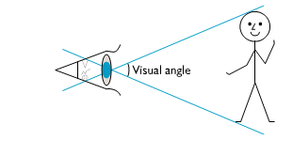
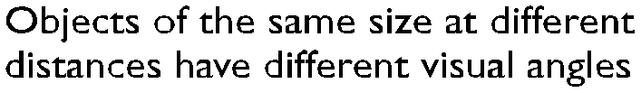
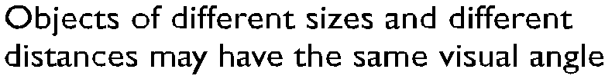
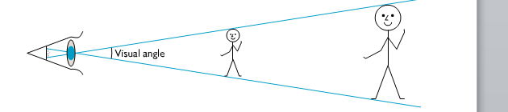
Interpreting the signal

Slide 17
Interpreting the signal
If the visual angle of an object is too small we will be unable to perceive it at all.
Visual acuity is the ability of a person to perceive ﬁne detail.
Visual acuity mostly measured by standard eye tests.
For example, a person with normal vision can detect a single line if it has a visual angle of 0.5 seconds of arc.

Slide 18
Interpreting the signal (cont)
Given that the visual angle of an object is reduced as it gets further away
In fact, our perception of an object’s size remains constant even if its visual angle changes.
familiar objects perceived as constant size
This is the law of size constancy, and it indicates that our perception of size relies on factors other than the visual angle.

Slide 19
Interpreting the signal (cont)
Brightness
  subjective reaction to levels of light
  affected by luminance of object (which is the amount of light emitted by an object.)
  The luminance of an object is dependent on the amount of light falling on the object’s surface and its reﬂective properties.
  Visual acuity increases with increased luminance.

Slide 20
Interpreting the signal (cont)
Colour
  Color is usually regarded as being made up of three components: hue, intensity and saturation.
  Hue is determined by the spectral wavelength of the light. Blues have short wavelengths, greens medium and reds long.
  Approximately 150 different hues can be discriminated by the average person

Slide 21
Interpreting the signal (cont)
Intensity is the brightness of the color, and
Saturation is the amount of whiteness in the color.
The eye perceives color because the cones are sensitive to light of different wavelengths.
There are three different types of cone, each sensitive to a different color (blue, green and red).

Slide 22
Interpreting the signal (cont)
Color vision is best in the fovea, and worst at the periphery where rods predominate.
It should also be noted that only 3–4% of the fovea is occupied by cones which are sensitive to blue light, making blue acuity lower.
8% of males and 1% of females suffer from color blindness, most commonly being unable to discriminate between red and green.

Slide 23
The capabilities and limitations of visual processing
The visual system compensates for:
  movement
  changes in luminance.
our expectations affect the way an image is perceived.
For example, if we know that an object is a particular size, we will perceive it as that size no matter how far it is from us.

Slide 24
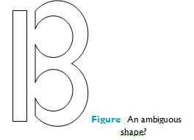
The capabilities and limitations of visual processing
Humans have ability to interpret and exploit expectations, this can be used to resolve ambiguity

Slide 25
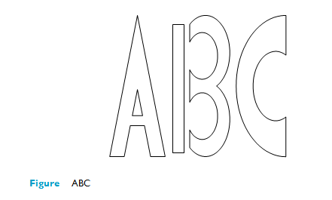
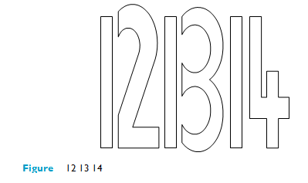
The capabilities and limitations of visual processing(cont..)
        The context in which the object appears allows our expectations to clearly disambiguate the interpretation of the object, as either a B or a 13.

Slide 26
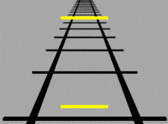
The capabilities and limitations of visual processing(cont..)
Optical Illusions
Optical illusions sometimes occur due to over compensation
the Ponzo illusion
the Muller Lyer illusion

Slide 27
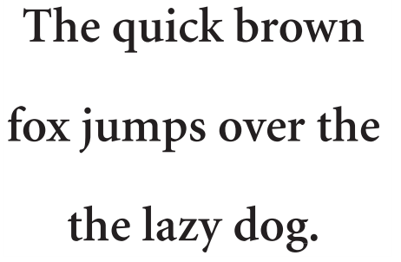
The capabilities and limitations of visual processing(cont..)
Proof-reading illusion.

Slide 28
Reading
There are several stages in the reading process.
First, the visual pattern of the word on the page is perceived.
Second decoded with reference to an internal representation of language.
The ﬁnal stages of language processing include syntactic and semantic analysis and operate on phrases or sentences.

Slide 29
Reading(cont..)
During reading, the eye makes jerky movements called saccades followed by ﬁxations.
Perception occurs during the ﬁxation periods, which account for approximately 94% of the time elapsed.
The eye moves backwards over the text as well as forwards, in what are known as regressions. If the text is complex there will be more regressions.

Slide 30
Reading(cont..)
Word shape is important to recognition, not each character. DIFFERENT, Different,
Font sizes 9-12 points is legible
Line lengths between 2.3-5.2inches is legible
Negative contrast improves reading from computer screen(dark characters on a light screen)

Slide 31
Hearing
Close your eyes for a moment and listen.
What sounds can you hear?
Where are they coming from?
What is making them?
Provides information about environment:
distances, directions, objects etc.

Slide 32
The Human Ear
hearing begins with vibrations in the air or sound waves.
The ear receives these vibrations and transmits them, through various stages, to the auditory nerves.
The ear comprises three sections, commonly known as the outer ear, middle ear and inner ear.

Slide 33
Hearing (cont)
Physical apparatus:
  outer ear (has two parts auditory canal and pinna)–protects middle ear from damage and amplifies sound
  middle ear – transmits sound waves as
  vibrations to inner ear
  inner ear – chemical transmitters are released
  and cause impulses in auditory nerve

Slide 34
Hearing (cont)
Sound
Sound is changes or vibrations in air pressure.
It has a number of characteristics which we can differentiate.
  pitch – sound frequency
  loudness – amplitude
  timbre – type or quality sound

Slide 35
Hearing (cont)
Humans can hear frequencies from 20Hz to 15kHz
Auditory system filters sounds
  can attend to sounds over background noise.
  for example, the cocktail party phenomenon.(unless too similar frequencies and too loud)

Slide 36
Design effect
Sound is rarely used- warning sounds and notifications, attract users’ attention to critical situations or end of a process etc..
Exception is multimedia- music, voice commentary, and sound effects.
The ear can differentiate sound changes and can recognize familiar sounds without concentrating attention on the sound source. This suggests that sound could be used more extensively in interface design,

Slide 37
Touch
Provides important feedback about environment.
May be key sense for someone who is visually impaired.
Stimulus received via receptors in the skin:
  Thermoreceptors – respond to heat and cold
  Nociceptors – respond to intense pressure, and pain,
  Mechanoreceptors – respond to pressure

Slide 38
Touch(cont..)
whole of the body contains such receptors, some areas have greater sensitivity or acuity than others.
Some areas more sensitive than others e.g. fingers.
Kinesthesis - awareness of the position of the body and limbs.
This is due to receptors in the joints.

Slide 39
Touch(cont...)
there are three types:
rapidly adapting, which respond when a limb is moved in a particular direction
slowly adapting, which respond to both movement and static position
Positional receptors, which only respond when a limb is in a static position.
This perception affects both comfort and performance.

Slide 40
Touch(cont...)
For example, for a touch typist, awareness of the relative positions of the ﬁngers and feedback from the keyboard are very important.

Slide 41
Movement
A simple action such as hitting a button in response to a question involves a number of processing stages.
The stimulus (of the question) is received through the sensory receptors and transmitted to the brain.
The question is processed and a valid response generated.
The brain then tells the appropriate muscles to respond.

Slide 42
Movement(cont..)
Each of these stages takes time, which can be roughly divided into reaction time and movement time.
Time taken to respond to stimulus:
reaction time + movement time
Movement time is dependent largely on the physical characteristics of the subjects: their age and ﬁtness,

Slide 43
Movement(cont..)
Reaction time varies according to the sensory channel through which the stimulus is received.
A person can react to an auditory signal in approximately 150 ms, to a visual signal in 200 ms and to pain in 700 ms.
A combined signal will result in the quickest response.

Slide 44
Movement (cont)
Factors such as skill or practice can reduce reaction time, and fatigue can increase it
Speed and accuracy of movement are important considerations in the design of interactive systems, Primarily in terms of the time taken to move to a particular target on a screen.

Slide 45
Memory
Much of our everyday activity relies on memory.
As well as storing all our factual knowledge, our memory contains our knowledge of actions or procedures.
It allows us to repeat actions, to use language, and to use new information received via our senses.
It also gives us our sense of identity, by preserving information from our past experiences.

Slide 46
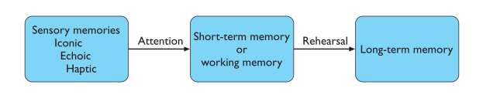
Memory(cont..)
Generally agreed that there are three types of memory or memory function: sensory memory , short-term memory or working memory, and long-term memory.

Slide 47
sensory memory
Buffers for stimuli received through senses
  iconic memory: visual stimuli
  echoic memory: aural stimuli
  haptic memory: touch stimuli
Information is passed from sensory memory into short-term memory by attention
Attention is the concentration of the mind on one out of a number of competing stimuli or thoughts.

Slide 48
Short-term memory (STM)
Short-term memory or working memory acts as a ‘scratch-pad’ for temporary recall of information.
It is used to store information which is only required ﬂeetingly. For example
calculate 35 × 6 in your head.
calculation done in stages, 5 × 6 and then 30 × 6 and added the results;
or 6 = 2 × 3 and calculated 2 × 35 =70 followed by 3 × 70.

Slide 49
Short-term memory (STM)
To perform calculations such as this we need to store the intermediate stages for use later.
Or consider reading. In order to comprehend this sentence you need to hold in your mind the beginning of the sentence as you read the rest.
Both of these tasks use short-term memory.

Slide 50
Short-term memory (STM)
Short-term memory can be accessed rapidly, in the order of 70 ms.
It also decays rapidly, meaning that information can only be held there temporarily, in the order of 200 ms.

Slide 51
Short-term memory (STM)
Short-term memory also has a limited capacity.
There are two basic methods for measuring memory capacity.
The ﬁrst involves determining the length of a sequence which can be remembered in order.
The second allows items to be freely recalled in any order.

Slide 52
Short-term memory (STM)
Using the ﬁrst measure, the average person can remember 7 ± 2 digits.
Example
212348278493202
0121 414 2626 3456

Slide 53
Short-term memory (STM)
chunking information can increase the short-term memory capacity.
The limited capacity of short-term memory produces a subconscious desire to create chunks, and so optimize the use of the memory.
The successful formation of a chunk is known as closure.

Slide 54
Long-term memory (LTM)
long-term memory is our main resource.
store factual information, experiential knowledge, procedural rules of behavior – in fact, everything that we ‘know’.
It differs from short-term memory in a number of signiﬁcant ways
  slow access ~ 1/10 second
  slow decay (forgetting occurs more slowly), if any
  huge or unlimited capacity

Slide 55
There are two types of long-term memory
  Episodic
  Semantic
Episodic memory represents our memory of events and experiences in a serial form.
Semantic memory is a structured record of facts, concepts and skills that we have acquired.
The information in semantic memory is derived from that in our episodic memory,
such that we can learn new facts or concepts from our experiences.
  .

Slide 56
Long-term memory (cont.)
Semantic memory structure
  provides access to information
  represents relationships between bits of information
  supports inference
Model: semantic network
  inheritance – child nodes inherit properties of parent nodes
  relationships between bits of information explicit
  supports inference through inheritance

Slide 57

LTM - semantic network

Slide 58
Models of LTM
A number of other memory structures have been proposed to explain how we represent and store different types of knowledge.
Semantic networks represent the associations and relationships between single items in memory.
They do not allow us to model the representation of more complex objects or events,

Slide 59
Models of LTM
Structured representations such as frames and scripts organize information into data structures.

Slide 60
Models of LTM - Frames
Information organized in data structures
Slots in structure instantiated with values for instance of data
Type–subtype relationships
DOG
Fixed
legs: 4
Default
diet: carniverous
sound: bark
Variable
size:
colour
COLLIE
Fixed
breed of: DOG
type: sheepdog
Default
size: 65 cm
Variable
colour

Slide 61
Models of LTM - Scripts
A script represents stereotypical information, allowing us to interpret partial descriptions or cues fully.
A script comprises a number of elements, which, like slots, can be ﬁlled with appropriate information:
Script for a visit to the vet
Entry conditions: dog ill
vet open
owner has money
Result: dog better
owner poorer
vet richer
Props: examination table
medicine
instruments
Roles: vet examines
diagnoses
treats
owner brings dog in
pays
takes dog out
Scenes: arriving at reception
waiting in room
examination
paying
Tracks: dog needs medicine
dog needs operation

Slide 62
Models of LTM - Production rules
A ﬁnal type of knowledge representation which hold in memory is the representation of procedural knowledge,
Condition/action rules
  if condition is matched
  then use rule to determine action.
IF dog is wagging tail
THEN pat dog
IF dog is growling
THEN run away

Slide 63
Long-term memory processes
There are three main activities related to long-term memory:
Storage
Forgetting and
Information retrieval.

Slide 64
LTM - Storage of information
Information from short-term memory is stored in long-term memory by rehearsal.
total time hypothesis
  The amount learned was directly proportional to the amount of time spent learning
  amount retained proportional to rehearsal time
distribution of practice effect
  optimized by spreading learning over time
  Example on week typing training with different time spent (1, 2, 4 hours )
structure, meaning and familiarity
  information easier to remember

Slide 65
LTM - Storage of information
If information is not meaningful it is more difﬁcult to remember.
it is more difﬁcult to remember a set of words representing concepts than a set of words representing objects.
List A: Faith Age Cold Tenet Quiet Logic Idea Value Past Large
List B: Boat Tree Cat Child Rug Plate Church Gun Flame Head

Slide 66
LTM - Forgetting
There are two main theories of forgetting:
decay and interference.
decay
  information is lost gradually but very slowly
interference
  new information replaces old: retroactive interference
  old may interfere with new: proactive inhibition

Slide 67
LTM - retrieval
two types of information retrieval,
Recall
  information reproduced from memory can be assisted by cues, e.g. categories, imagery
Recognition
  information gives knowledge that it has been seen before
  less complex than recall - information is cue

Slide 68
Thinking
How information is processed and manipulated.
This is perhaps the area which is most complex and which separates humans from other information-processing systems.
Thinking can require different amounts of knowledge.
Some thinking activities are very directed and the knowledge required is constrained.

Slide 69
Thinking(cont.. )
Others require vast amounts of knowledge from different domains.
For example, performing a simple subtraction calculation requires a relatively small amount of knowledge, from constrained domain, whereas understanding newspaper headlines demands knowledge of politics, social structures, public ﬁgures and world events.

Slide 70
Thinking has two categories
Reasoning
deduction, induction, abduction
2.Problem solving

Slide 71
Reasoning
Reasoning is the process by which we use the knowledge we have to draw conclusions or infer something new about the domain of interest.
There are a number of different types of reasoning:
Deductive
Inductive
Abductive.

Slide 72
Deductive Reasoning
Deduction:
  derive logically necessary conclusion from given premises.
  e.g. If it is Friday then she will go to work
  It is Friday
  Therefore she will go to work.
  Inductive Reasoning
Induction:
  generalize from cases seen to cases unseen
  e.g. all elephants we have seen have trunks
  therefore all elephants have trunks.
This inference is unreliable and cannot be proved to be true.

Slide 73
Deductive Reasoning
We can disprove the inference simply by producing an elephant without a trunk.
However, we can never prove it true because, no matter how many elephants with trunks we have seen or are known to exist, the next one we see may be trunkless.

Slide 74
Abductive reasoning
reasoning from event to cause
  e.g. Sam drives fast when drunk.
  If I see Sam driving fast, assume drunk.
Unreliable:
  can lead to false explanations
  there may be another reason why she is driving fast: she may have been called to an emergency,

Slide 75
Problem solving
Problem solving is the process of ﬁnding a solution to an unfamiliar task, using the knowledge we have.
Human problem solving is characterized by the ability to adapt the information we have to deal with new situations.
There are a number of different views of how people solve problems among them:
Gestalt theory and Problem space theory
Individual Assignment: write 1 or 2 page report about the two human problem solving theories

Slide 76
Errors and mental models
Human capability for interpreting and manipulating information is quite impressive. However, we do make mistakes.
Some are trivial, resulting in no more than temporary inconvenience or annoyance.
Others may be more serious, requiring substantial effort to correct. Occasionally an error may have catastrophic effects, as we see when ‘human error’ results in a plane crash or nuclear plant leak.

Slide 77
Errors and mental models
some errors result from changes in the context of skilled behavior.
If a pattern of behavior has become automatic and we change some aspect of it, the more familiar pattern may break through and cause an error.
Other errors result from an incorrect understanding, or model, of a situation or system.

Slide 78
Errors and mental models
People build their own theories to understand the causal behavior of systems. These have been termed mental models.
They have a number of characteristics. Mental models are often partial: the person does not have a full understanding of the working of the whole system

Slide 79
Emotion
Various theories of how emotion works
  James-Lange: emotion is our interpretation of a physiological response to a stimuli
  Cannon: emotion is a psychological response to a stimuli
  Schacter-Singer: emotion is the result of our evaluation of our physiological responses, in the light of the whole situation we are in
Emotion clearly involves both cognitive and physical responses to stimuli

Slide 80
Emotion (cont.)
The biological response to physical stimuli is called affect
Affect influences how we respond to situations
  positive → creative problem solving
  negative → narrow thinking
  “Negative affect can make it harder to do even easy tasks; positive affect can make it easier to do difficult tasks”
        (Donald Norman)

Slide 81
Emotion (cont.)
Implications for interface design
  stress will increase the difficulty of problem solving
  relaxed users will be more forgiving of shortcomings in design
  aesthetically pleasing and rewarding interfaces will increase positive affect

Slide 82
Individual differences
In this chapter we have been discussing humans in general.
We have made the assumption that everyone has similar capabilities and limitations and that we can therefore make generalizations.
although we share processes in common, humans, and therefore users, are not all the same.

Slide 83
We should be aware of individual differences so that we can account for them as far as possible within our designs.
These differences should be taken into account in our designs.
It is useful to consider, for any design decision, if there are likely to be users within the target group who will be adversely affected by our decision.

Slide 84
Individual differences
long term
– sex, physical and intellectual abilities
short term
– effect of stress or fatigue
changing
– age

Slide 85
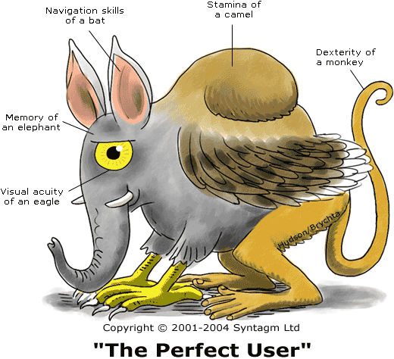
The Perfect User (every designer ‘s wish)

Slide 86
Question?

